Slide 1
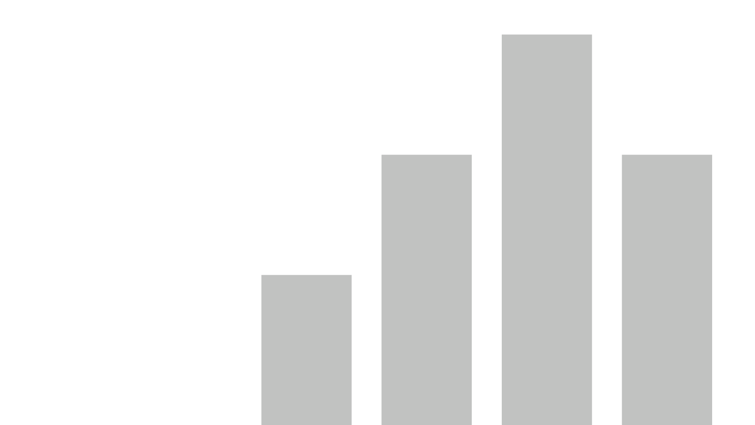



Obesity Data Analysis
View in Power BI
Data Dictionary
POWER BI
PYTHON Analysis
Label Encoding
Model Building
Streamlit Deployment
BY:
ALONGE DANIEL OLUWASEGUN
LINKEDIN
GITHUB
Last data refresh:
6/9/2024 10:46:21 AM UTC
Downloaded at:
6/9/2024 7:35:08 PM UTC

Slide 2
DATA DICTIONARY

Slide 3
About Dataset Obesity
Obesity, which causes physical and mental problems, is a global health problem with serious consequences. The prevalence of obesity is increasing steadily, and therefore, new research is needed that examines the influencing factors of obesity and how to predict the occurrence of the condition according to these factors.
https://www.semanticscholar.org/paper/Estimation-of-Obesity-Levels-with-a-Trained-Neural-Ya%C4%9F%C4%B1n-G%C3%BCl%C3%BC/2c1eab51db154493d225c8b86ba885bbaf147a2c "
Dataset Information
This dataset include data for the estimation of obesity levels in individuals from the countries of Mexico, Peru and Colombia, based on their eating habits and physical condition. The data contains 17 attributes and 2111 records, the records are labeled with the class variable NObesity (Obesity Level), that allows classification of the data using the values of Insufficient Weight, Normal Weight, Overweight Level I, Overweight Level II, Obesity Type I, Obesity Type II and Obesity Type III. 77% of the data was generated synthetically using the Weka tool and the SMOTE filter, 23% of the data was collected directly from users through a web platform.

Slide 4
Gender: Feature, Categorical, "Gender"
Age : Feature, Continuous, "Age"
Height: Feature, Continuous
Weight: Feature Continuous
family_history_with_overweight: Feature, Binary, " Has a family member suffered or suffers from overweight? "
FAVC : Feature, Binary, " Do you eat high caloric food frequently? "
FCVC : Feature, Integer, " Do you usually eat vegetables in your meals? "
NCP : Feature, Continuous, " How many main meals do you have daily? "
CAEC : Feature, Categorical, " Do you eat any food between meals? "
SMOKE : Feature, Binary, " Do you smoke? "
CH2O: Feature, Continuous, " How much water do you drink daily? "
SCC: Feature, Binary, " Do you monitor the calories you eat daily? "
FAF: Feature, Continuous, " How often do you have physical activity? "
TUE : Feature, Integer, " How much time do you use technological devices such as cell phone, videogames, television, computer and others? "
CALC : Feature, Categorical, " How often do you drink alcohol? "
MTRANS : Feature, Categorical, " Which transportation do you usually use? "
NObeyesdad : Target, Categorical, "Obesity level"

Slide 5
POWER BI ANALYSIS

Slide 6
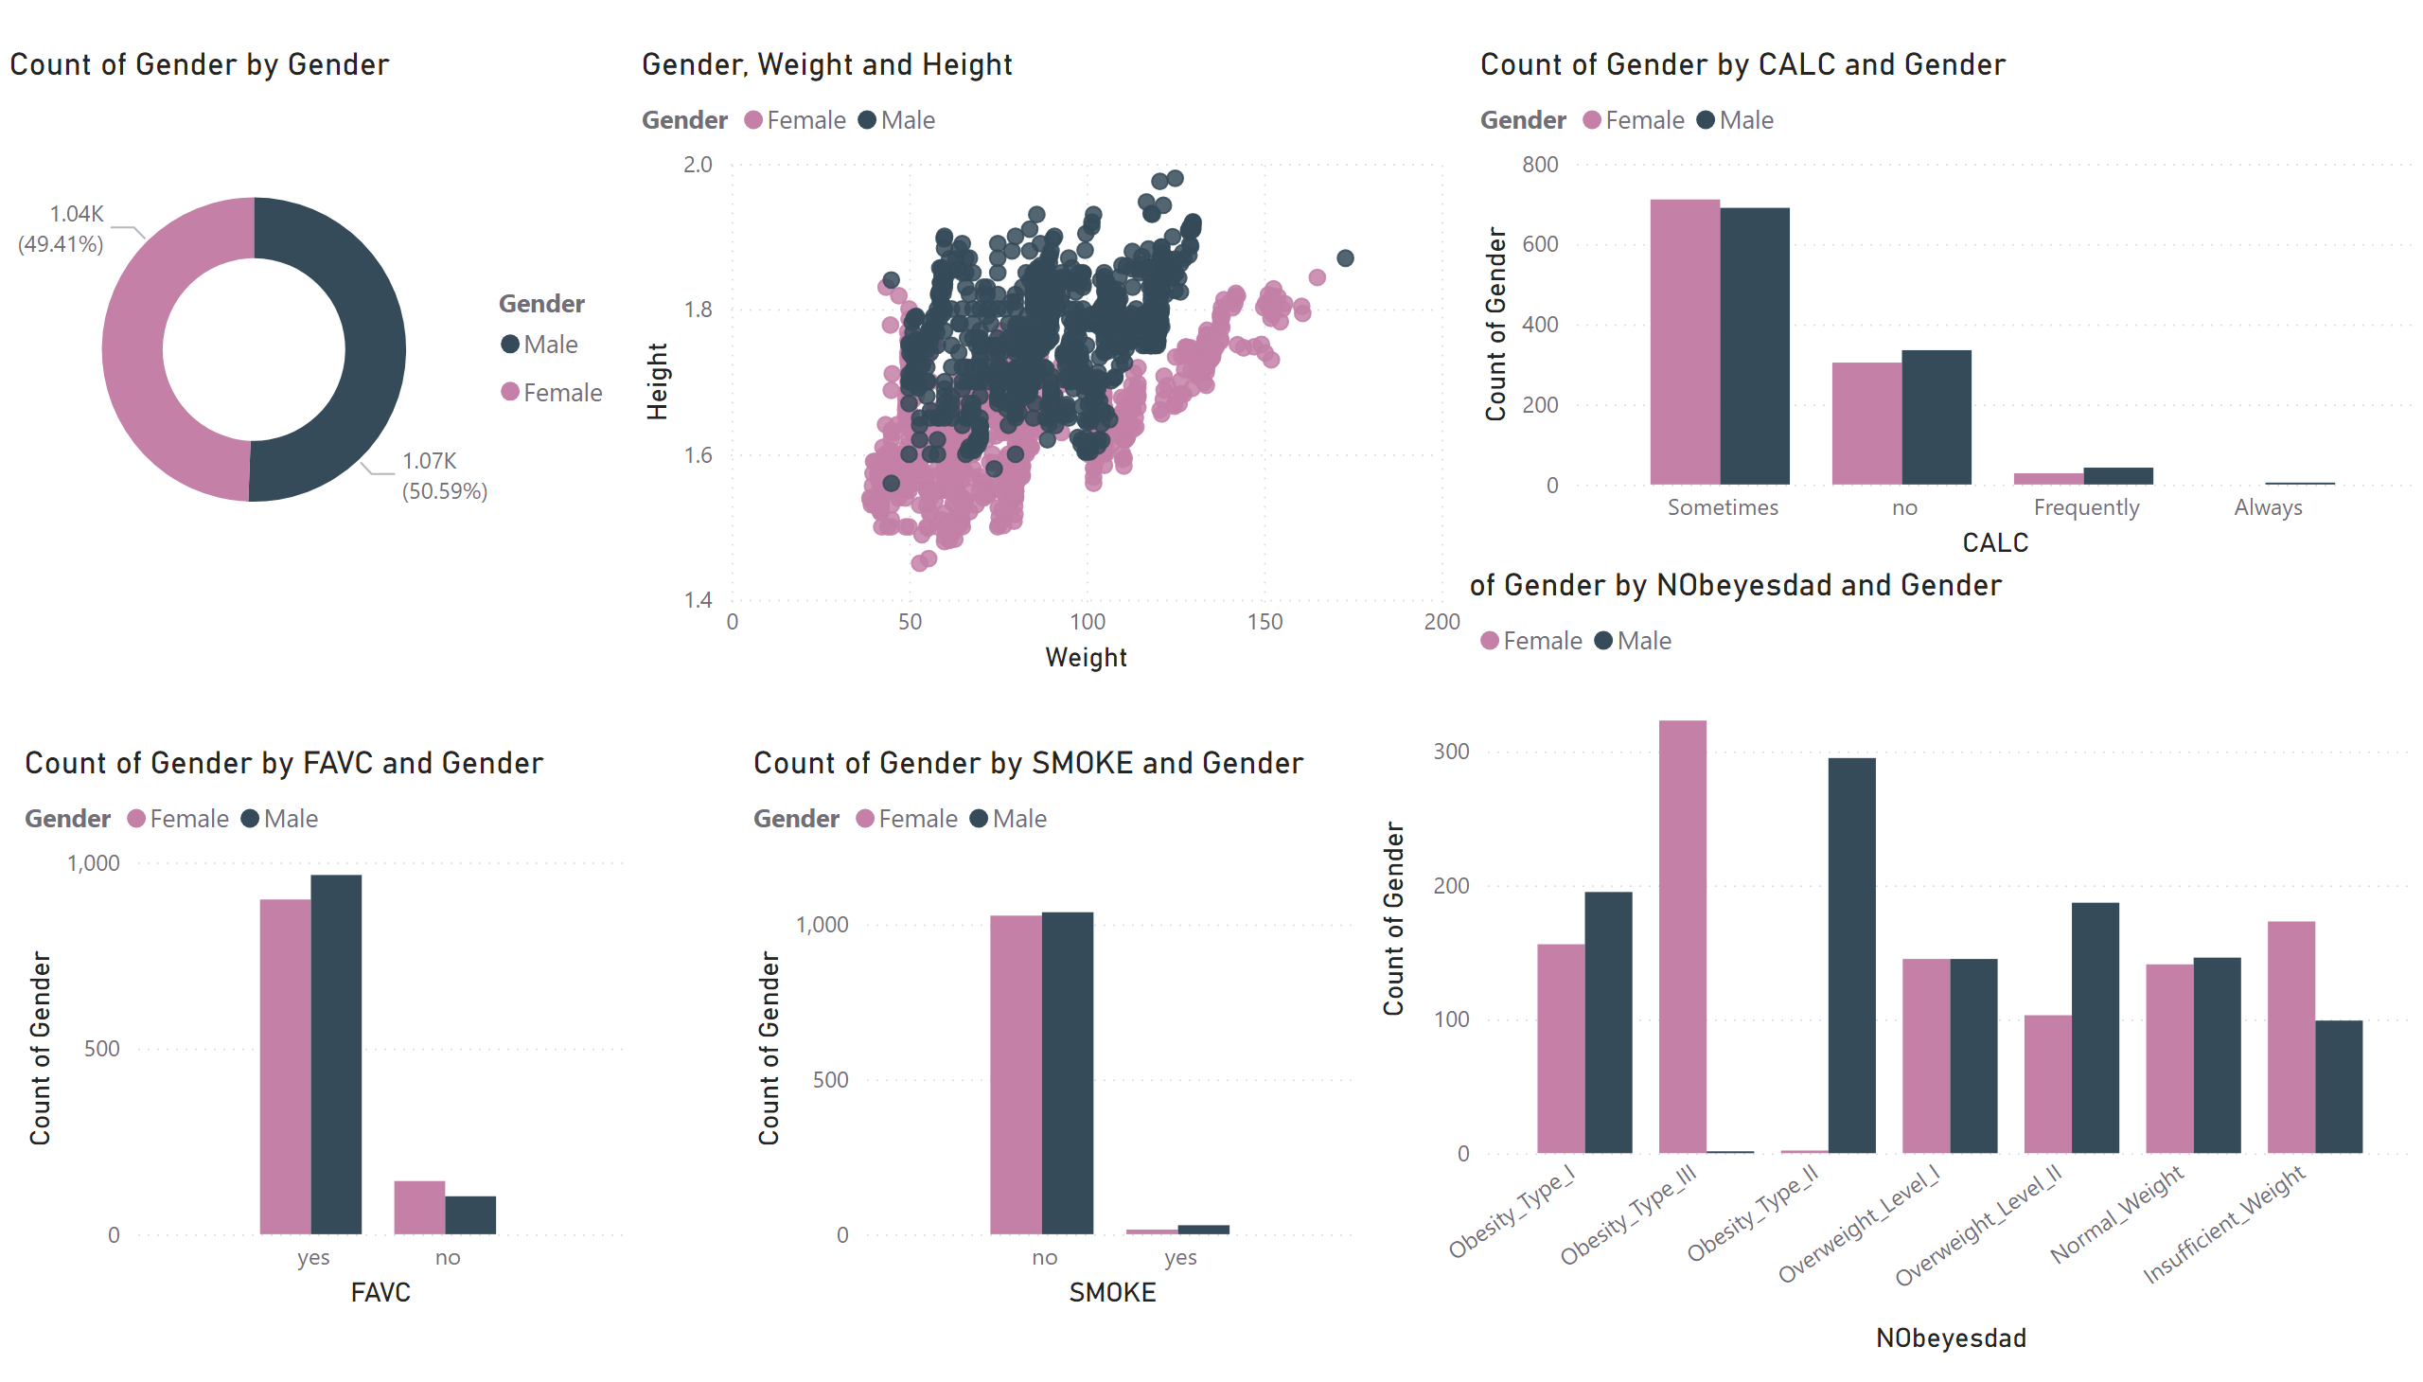
Gender Vs Others
Notes:
Gender By CALC
Shows if they eat between meals or not grouped by Gender
Gender Donut Chart
Shows the number of Male and Female present in Data which show evenly Distribution
Count Of Gender by FAVC
This is the response to the question f they eat high caloric food often by male and female respectfully
By Smoke and Gender
The count of smokers among respective columns
Scatter Plot Weight vs Height
Shows the relationships between Height and Weight in respect to gender which shows Male tends to be more taller while Females are more Heavier
Gender By Nobeyesdad
Shows count of each gender by various classes of obesity

Slide 7
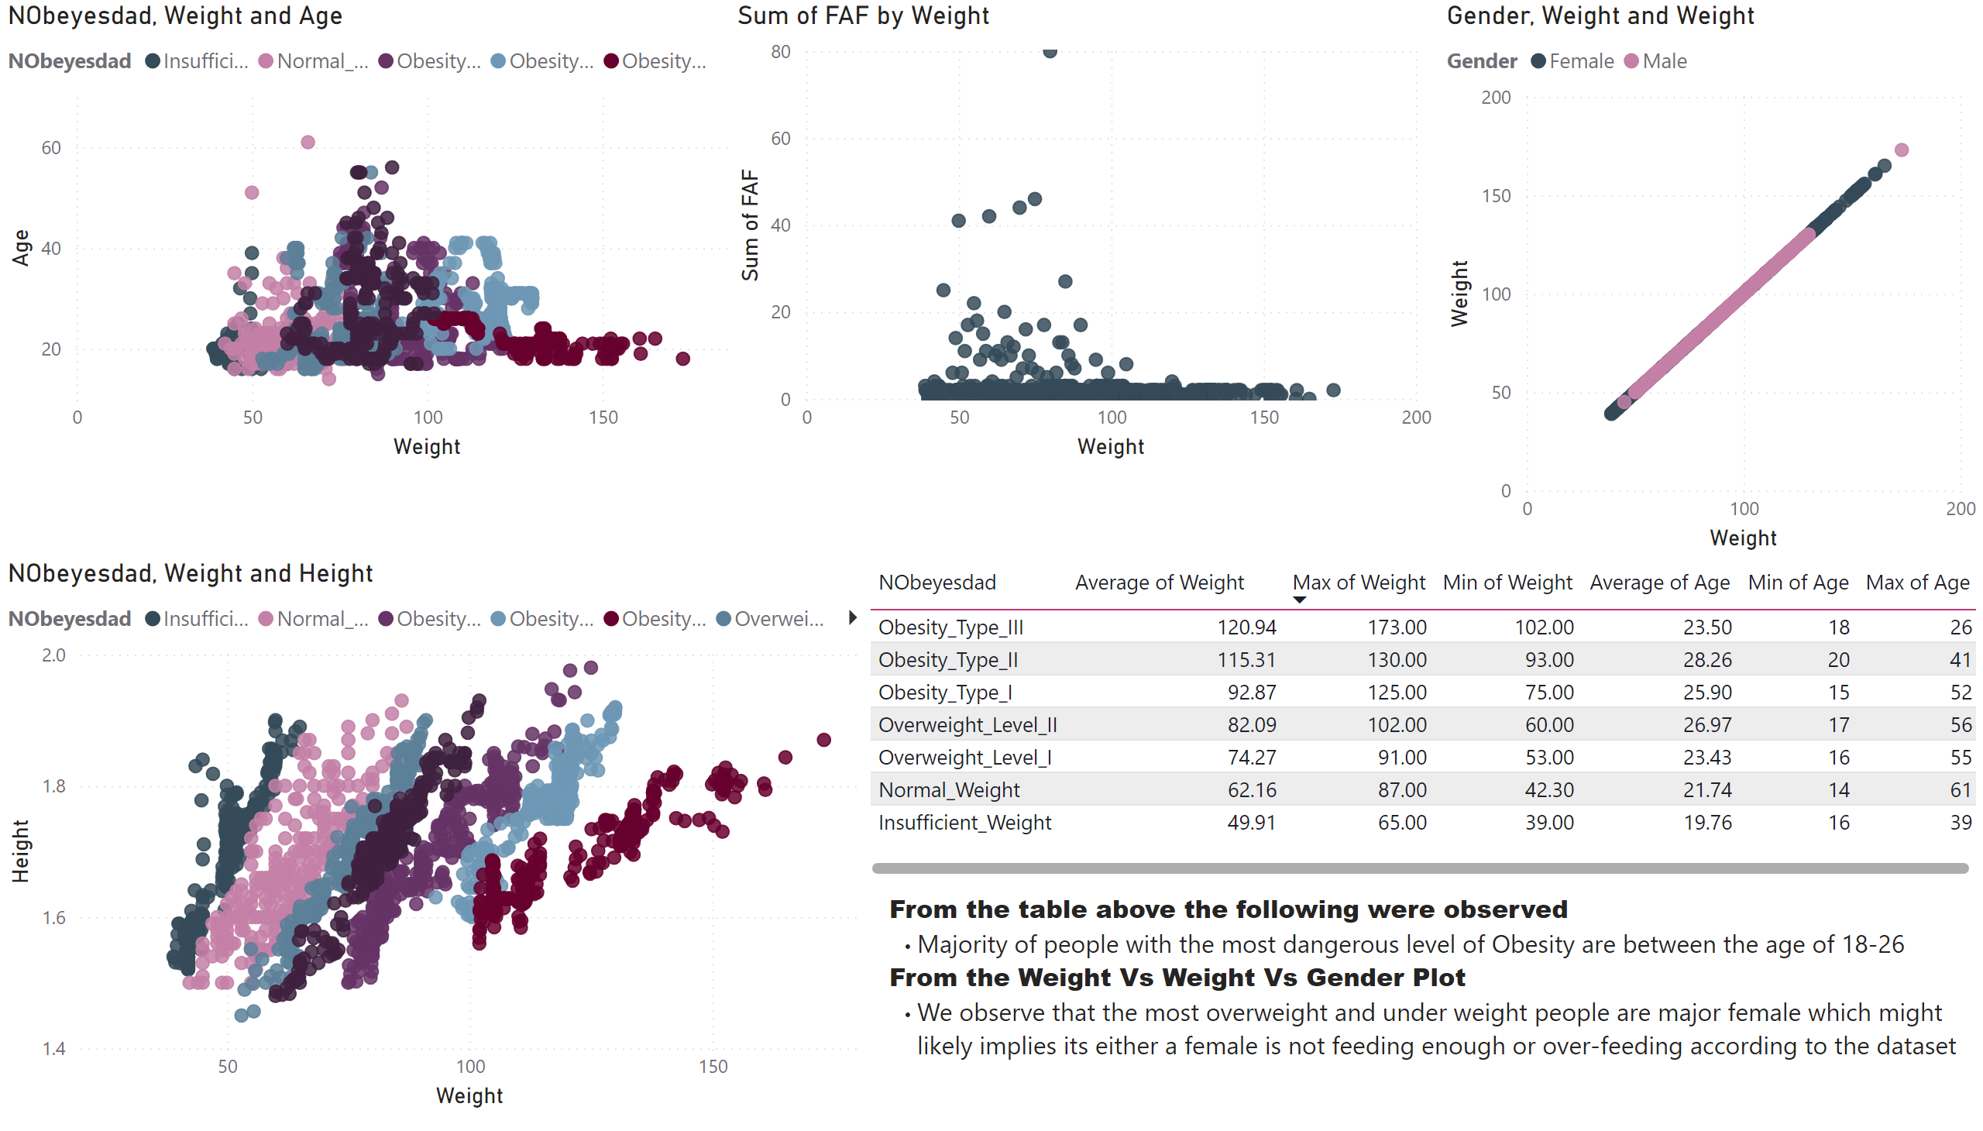
Weight Vs Others
Notes:
Weight and Age
Distribution of Age by Weight
Weight Vs Weight By Gender
Shows increment in weight by gender
Weight
Shows weight Vs Height in respect to various Class and Type of Obesity
Table
Shows summary details

Slide 8
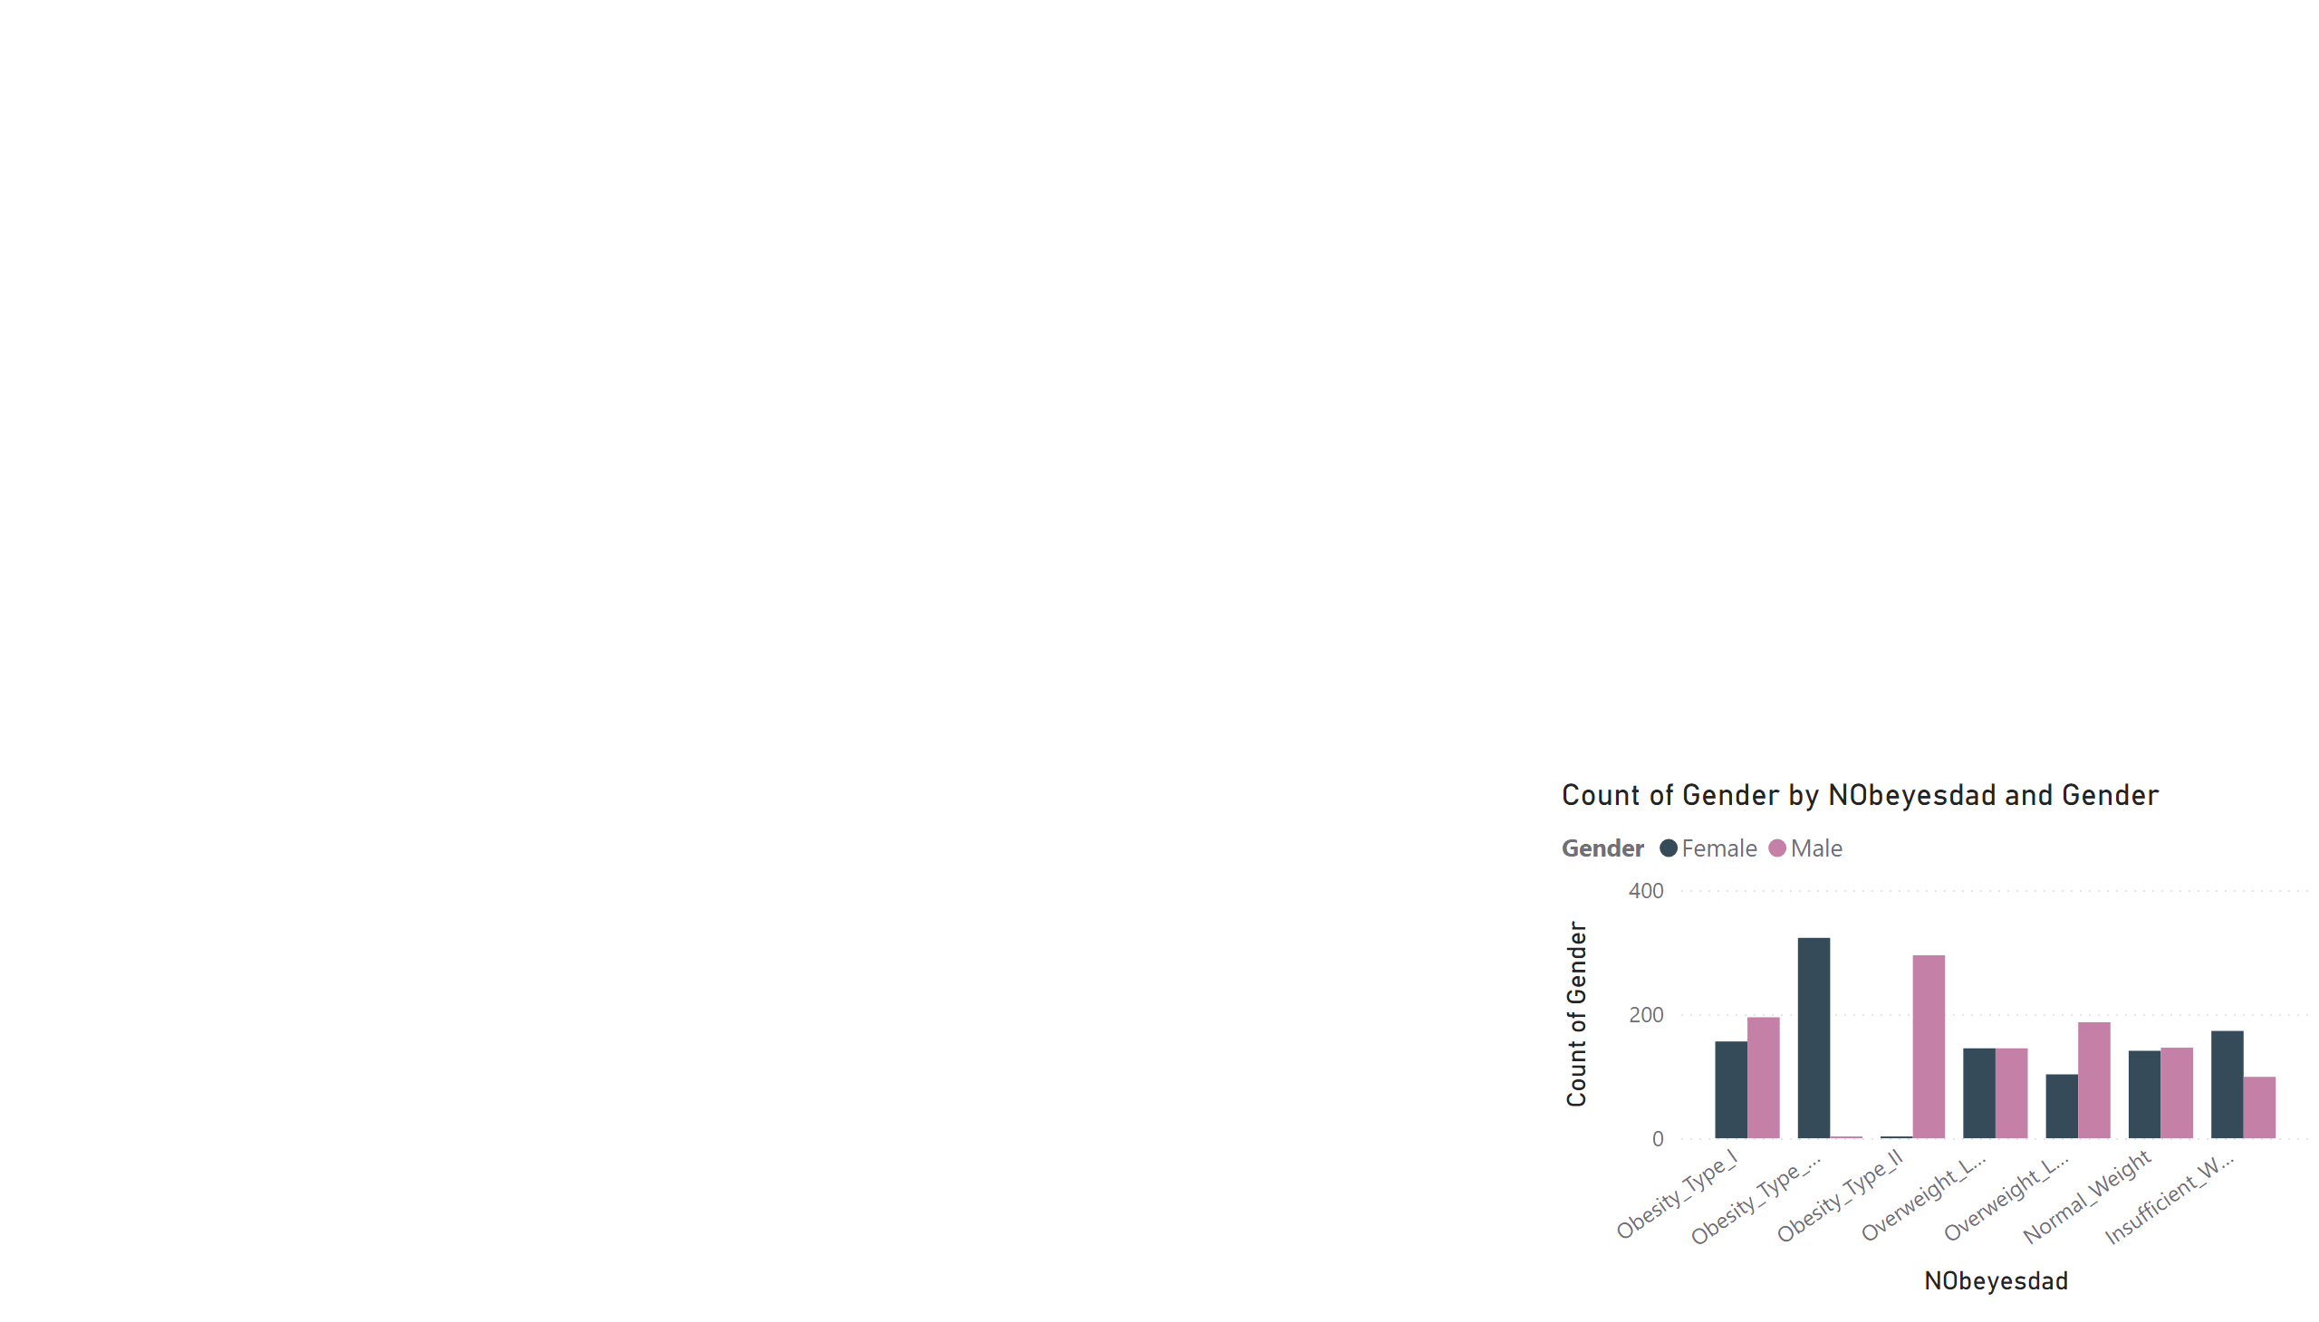
Dashboard
Notes:
Count Of Gender By Obesity Class

Slide 9
PYTHON ANALYSIS

Slide 10
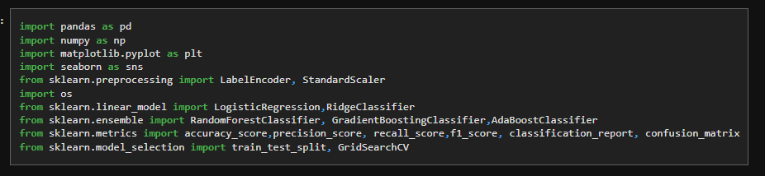
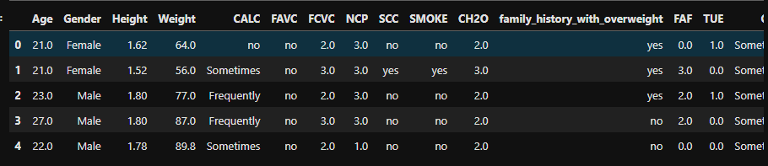
IMPORTING LIBRARIES
Data Head

Slide 11
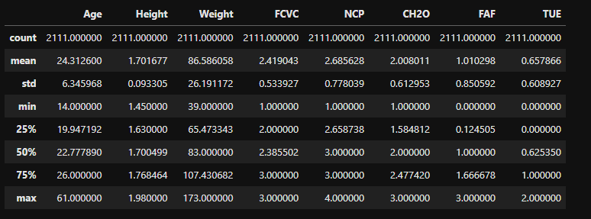
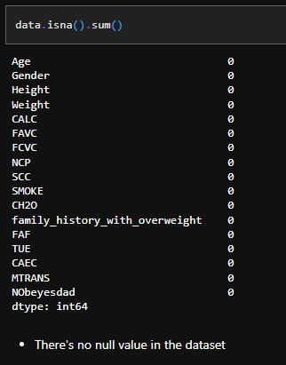
DATA SUMMARY
No Null Value
In the Data
The Summary for Numerical columns
In the data, which includes count,
Mean, 50 percentile, etc..

Slide 12
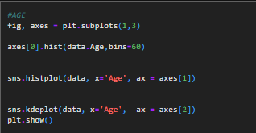
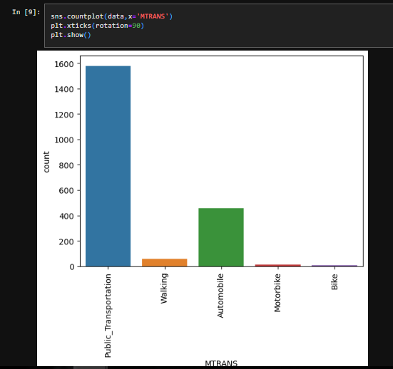
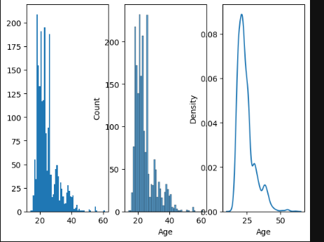
Mode Of Transportation Count Plot
AGE Distribution
As Expected Public Transportation
is the most common mode of transportation
Notes:
Age Distribution: Shows a slightly right skewnwss

Slide 13
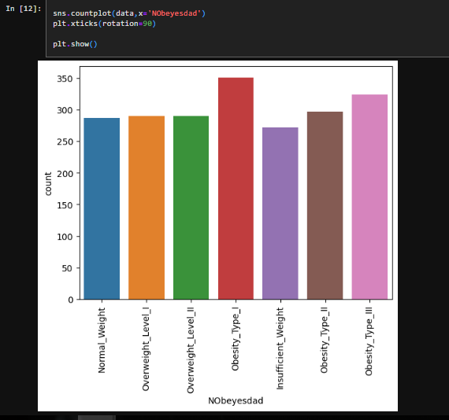
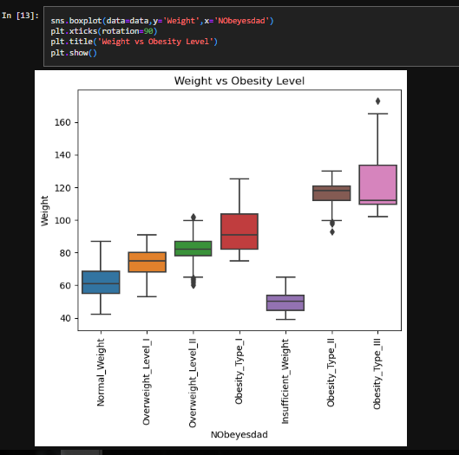
Obesity Class Count Plot
Weight Vs Obesity Level Relationship
Obesity Type One is the Highest count class
Notes:
BOX Plot shows Correlation between Weight and Obesity Level

Slide 14
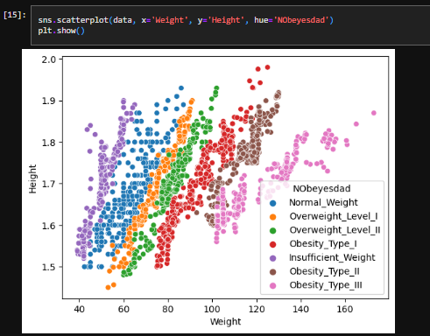
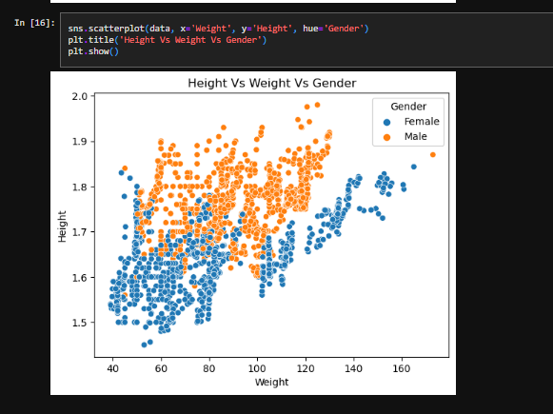
Multivariate Analysis
Height Vs Weight Vs Oesity Class
Height Vs Weight vs Gender
Note: There’s a similar plots for this page in the Power Bi section

Slide 15
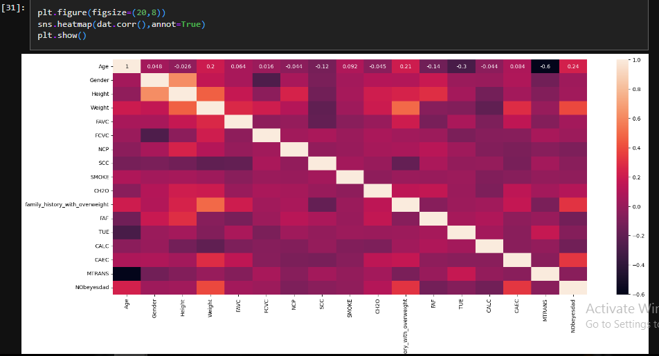
HeatMAP
Notes:
The Heatmap Confirms our assumption of the weight being highly correlated with the Obesity Class

Slide 16
LABEL ENCODING

Slide 17
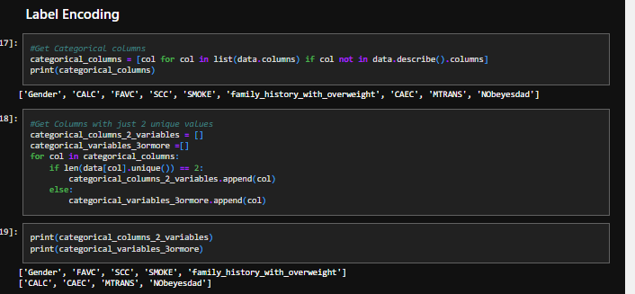
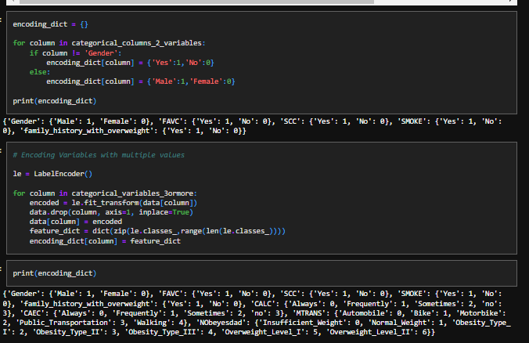
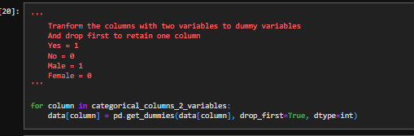
Multivariate Analysis
Codes For Label Encoding
Shows codes for label encoding which includes the use of,
Dummy variables and label encoders, and also the encoding dictionary
Is attached and save for easy access to labels during encoding

Slide 18
MODEL BUILDING

Slide 19
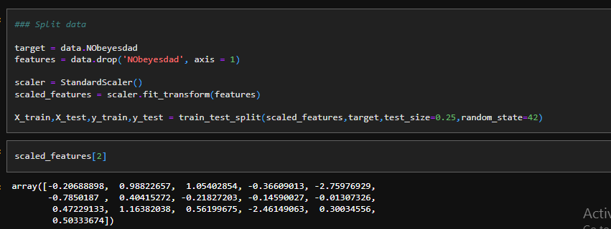
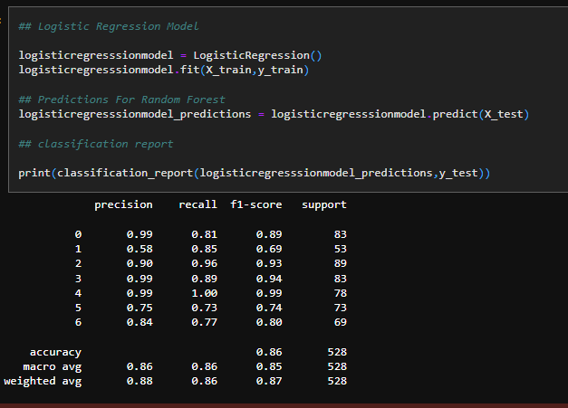
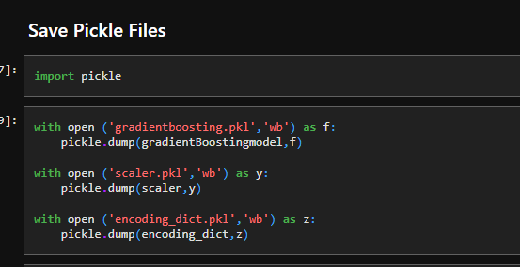
Scaling and Splitting Data
Logistic regression Algorithm
Save Files

Slide 20
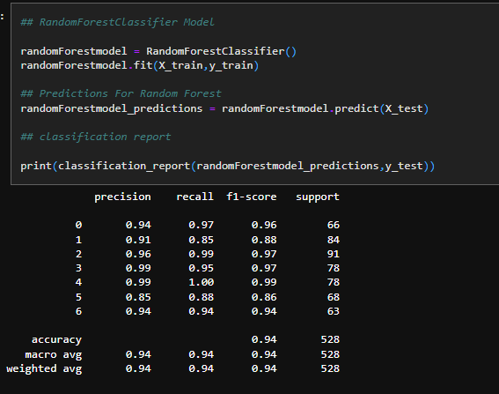
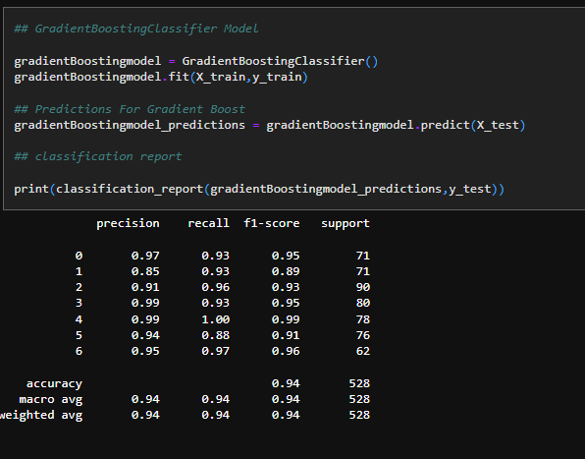
Random Forest Algorithm
Gradient Boosting Algorithm

Slide 21
STREAMLIT DEPLOYMMENT

Slide 22
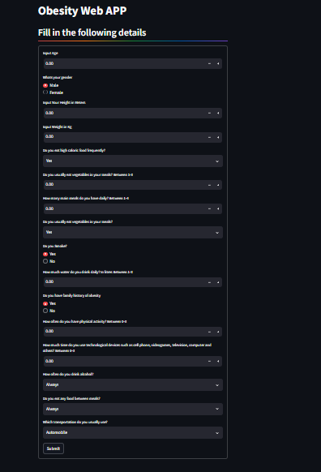
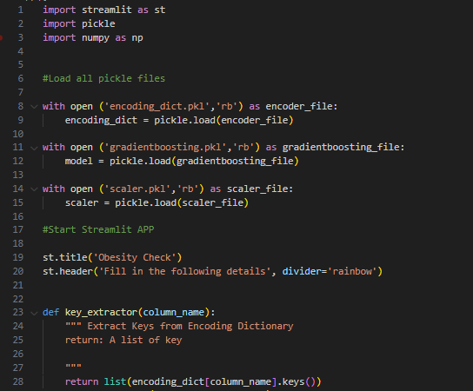
STREAMLIT APP HOMEPAGE
Streamlit Code Snippets

Slide 23
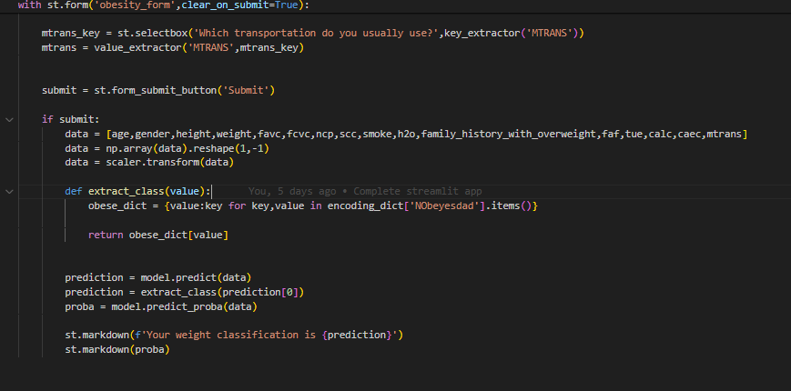
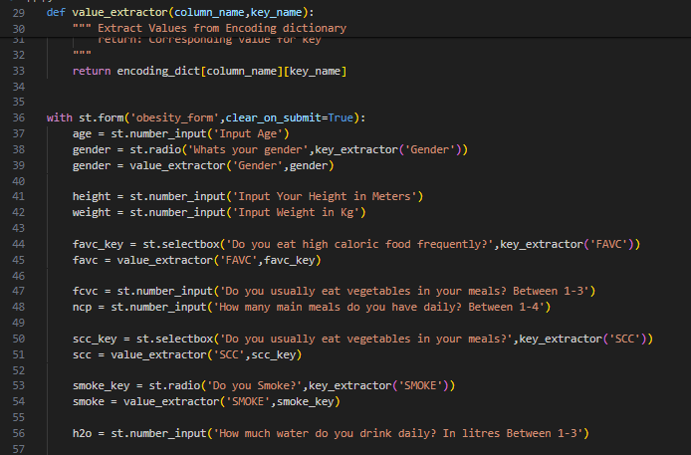
Streamlit Code Snippets

Slide 24
Kindly check Each slide notes for additional information's
Data was Download from Kaagle, link is available in the Data dictionary Page
Ipynb file and streamlit app file can be find at github

Slide 25
THANK YOU !!!!

